Slide 1
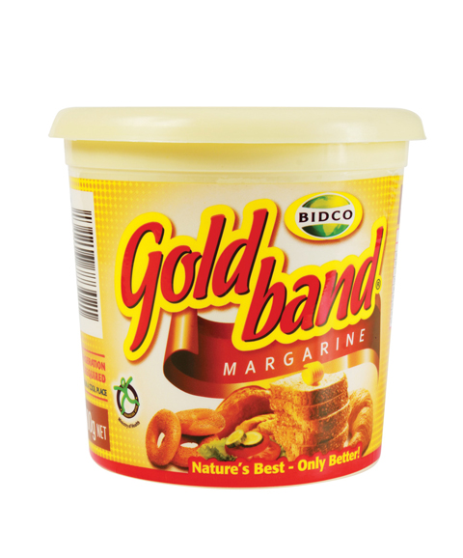
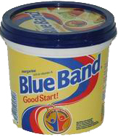
THE BASELINE
Gold Band Margarine is manufactured by Bidco, and is widely available in 250g, 500g, 1kg and 10kg packs through small stores and mini-marts in Nairobi.
The primary mass-market competitor to Gold Band is Blue Band (Unilever).
The baseline sales data for these competings product in the three pilot stores (Nafuu Supermarket, Naks Supermarket, Mary’s Mini-Mart) is set out below.

Slide 2
THE CAMPAIGN
Gold Band video advertising was delivered via the KOKOpoints at these three shops over the 8 week period from 1 February to 29 March 2017.
3 types of Gold Band video ads were targeted at female customers only during this period.
Each female customer was shown a 30 second video ad for Gold Band once per week, during the dispensing process for SmartCook fuel.
PICTURE OF GOLD BAND
VIDEO ADS SHOWN

Slide 3
THE RESULTS
25%
35%
February sales, against baseline average
February sales, against baseline average
20%
30%
February sales, against baseline average
February sales, against baseline average

